Slide 1



Comparing Android with other Platforms Session No.: 5 Course Name: Mobile Application Development Course Code: R1UC631B Instructor Name: Mr.P.Uppiliraja

Slide 2
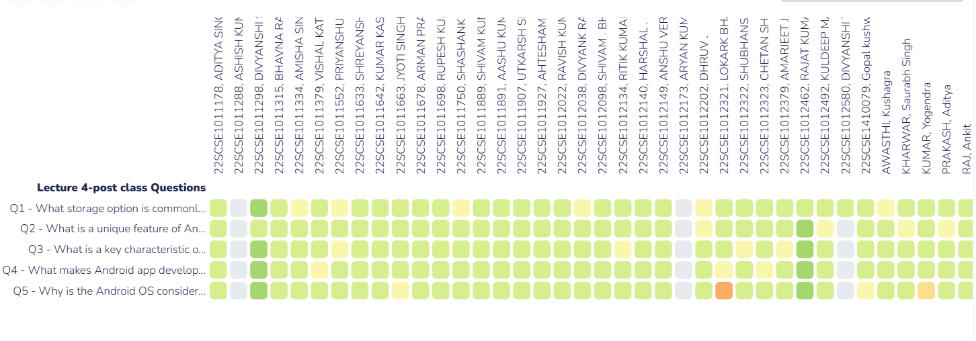
Reflect on the responses of post session activity

Slide 3

What factors do you think for success or failure of any product(OS)?

Slide 4
At the end of this session students will be able to
Learning Outcome 1: Identify various mobile platforms.
Learning Outcome 2: Distinguish among various mobile platforms.

Slide 5
Session Outline
1. Identify various mobile platforms.
2 Distinguish among the mobile platforms.

Slide 6

Concept and Definition for Learning Activity 1

Slide 7
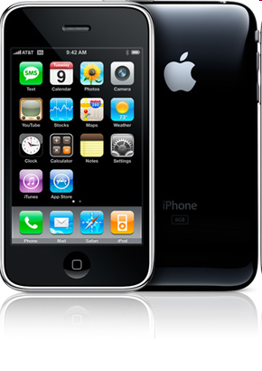
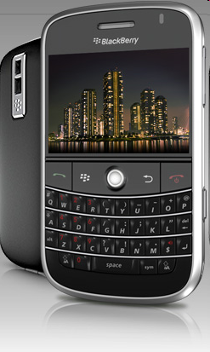
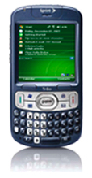
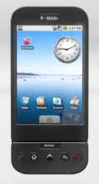





Various Mobiles & Mobile OS

Slide 8
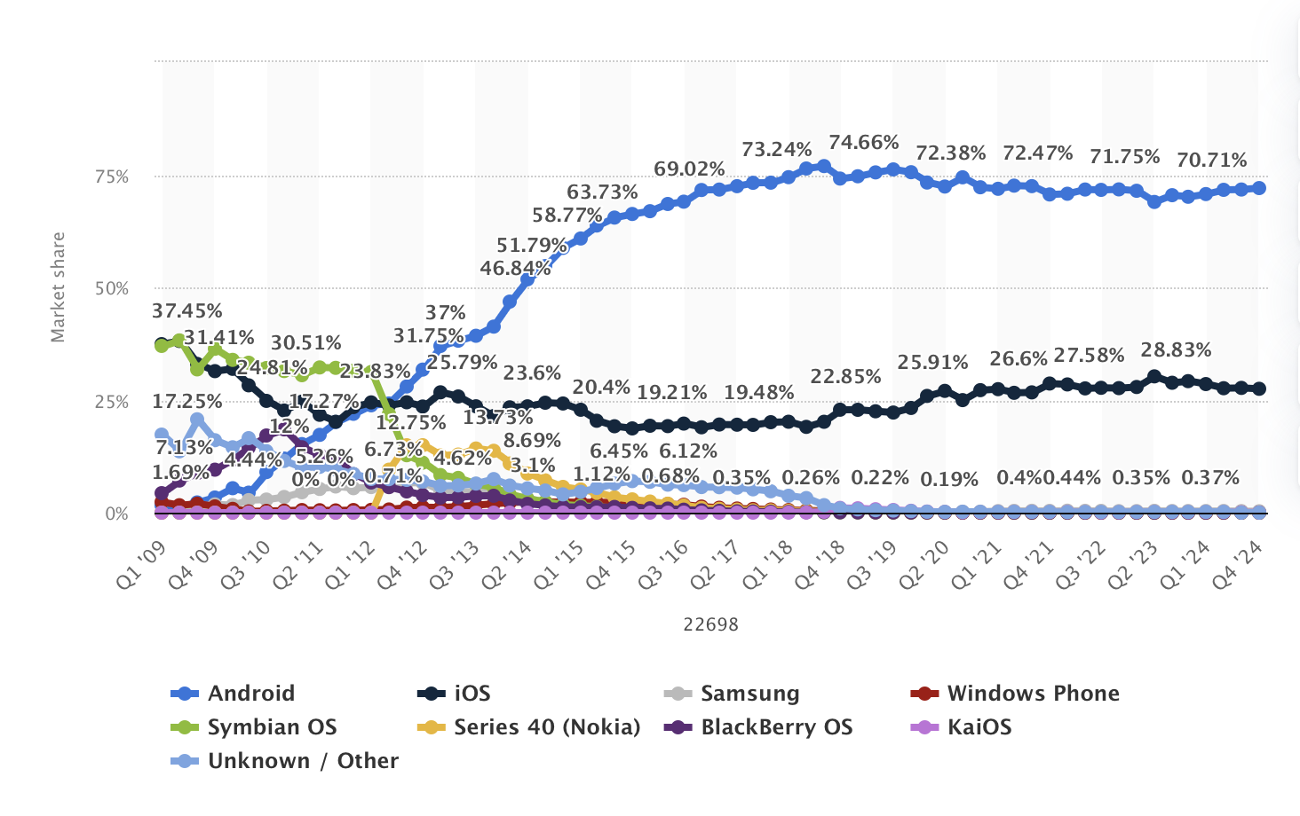
Market share of mobile operating systems worldwide from 2009 to 2024, by quarter

Slide 9


Learning Activity 1: Think-Pair-Share
Think (2mins)
Individually, students analyze a market share graph or dataset showcasing mobile OS trends from 2009 to 2024.
Each student identifies key insights, such as:
Which OS experienced the most growth?
Which OS declined or disappeared over time?
What external factors such as technological advancements, competition, or user preferences influenced these trends?
Pair (5 minutes)
Students pair up to compare observations and discuss:
What factors contributed to Android and iOS dominating the market?
What strategic or technical failures led to the decline of BlackBerry, Symbian, and Windows Phone?
Share (5 minutes)
Pairs join a larger class discussion to present their insights.

Slide 10
Contd.
OS | Q1 2009 | Q4 2024 | Expected 2025
Android | 1.69% | 72.04% | 71.72%
iOS | 37.45% | 27.49% | 27.81%
Samsung | 0% | 0.31% | 0.29%
Windows Phone | 2.3% | 0.01% | 0.01%
Symbian OS | 36.94% | 0% | 0%
Series 40 (Nokia) | 0% | 0% | 0%
BlackBerry OS | 4.37% | 0% | 0%
KaiOS | 0% | 0.03% | 0.03%
Unknown / Other | 17.25% | 0.01% | 0.11%
Android has a larger global market share compared to iOS, making it the most popular mobile operating system worldwide.

Slide 11
Learning Activity 2: Jigsaw
Group 1: Android
Group 2: iOS
Group 3: Samsung OS (Tizen)
Group 4: Windows Phone
Group 5: Symbian OS
Group 6: Series 40 (Nokia)
Group 7: BlackBerry OS
Group 8: KaiOS
Group 9: Android
One student from each group move into Expert Groups where everyone has the same assigned topic. Each expert group researches and discusses. Return to Home Groups & Teach

Slide 12
Comparison among various mobile platforms

Slide 13
Feature/Aspect | Android | iOS | Samsung OS (Tizen) | Windows Phone | Symbian OS | Series 40 (Nokia) | BlackBerry OS | KaiOS
Years Active | 2008 - Present | 2007 - Present | 2012 - Present | 2010 - 2019 | 1997 - 2014 | 1999 - 2014 | 1999 - 2016 | 2017 - Present
Developer | Google | Apple | Samsung | Microsoft | Nokia | Nokia | BlackBerry | KaiOS Technologies
Programming Languages | Java, Kotlin, Dart (Flutter), C++ | Swift, Objective-C | C, C++, HTML5 | C#, XAML | C++, Symbian C | Java (J2ME) | Java, C++ | HTML5, JavaScript
App Store | Google Play Store | Apple App Store | Tizen Store | Windows Store (discontinued) | Nokia Ovi Store (discontinued) | Nokia Store (discontinued) | BlackBerry World (discontinued) | KaiOS Store
Market Share (2025) | 71.72% | 27.81% | 0.29% | 0.01% | 0% | 0% | 0% | 0.03%
App Distribution | Open-source, flexible, multiple stores (Google Play, Amazon, etc.) | Closed ecosystem, strictly controlled | Limited, Samsung’s own store | Discontinued, limited third-party sources | Discontinued | Discontinued | Discontinued | Limited, focused on feature phones
UI Frameworks | Jetpack Compose, XML | SwiftUI, UIKit | HTML5, Tizen .NET | XAML, WinUI | Symbian UI | Series 40 UI | Cascades, Java-based UI | HTML5, KaiUI
Security Model | Open-source, sandboxed apps, Google Play Protect | Strict sandboxing, encrypted app installs | Secure, but limited app review | Secure but outdated | Legacy, weak security | Basic security | Business security features | Lightweight, basic security

Slide 14
Feature/Aspect | Android | iOS | Samsung OS (Tizen) | Windows Phone | Symbian OS | Series 40 (Nokia) | BlackBerry OS | KaiOS
Customizability | High | Low | Medium | Low | Medium | Low | Medium | Low
Multitasking Support | Yes | Yes | Yes | Yes | Limited | No | Yes | Limited
Target Devices | Smartphones, Tablets, Wearables, TV, IoT | iPhones, iPads, Mac integration | Samsung Smartwatches, TVs, IoT | Discontinued phones | Old Nokia phones | Feature phones | Enterprise and security-focused phones | Feature phones, low-end devices
Open Source | Yes | No | Partially | No | No | No | No | Partially
Performance | High (varies by manufacturer) | High (optimized for Apple devices) | Moderate | Moderate | Low | Low | Moderate | Low
App Monetization | Ads, in-app purchases, paid apps | Paid apps, in-app purchases, subscriptions | Limited revenue sources | Discontinued | Discontinued | Discontinued | Discontinued | Ads-based
Voice Assistant | Google Assistant | Siri | Bixby | Cortana (Discontinued) | No | No | No | No
Future Viability | Dominant | Strong | Niche | Dead | Dead | Dead | Dead | Niche (emerging markets)

Slide 15
Reflection- Learning Activity 2
How has the evolution of mobile operating systems impacted user experience and application development?
Why do you think Android and iOS continue to dominate the market while others have faded?
What were the key technical limitations that led to the decline of Symbian, BlackBerry OS, and Windows Phone?
If you were to develop a new mobile OS today, what features would you prioritize to compete with Android and iOS?

Slide 16
Summary
Android and iOS are the only two actively maintained and dominant platforms in 2025.
Samsung OS (Tizen) is mostly used in Samsung smart devices, not smartphones.
Windows Phone, Symbian, Series 40, and BlackBerry OS are discontinued.
KaiOS is surviving in feature phone markets.
Other/Unknown platforms have negligible impact

Slide 17
Ensure attainment of LOs in alignment to the learning activities: outcomes (1-2)
Outcome 1: Students can identify various mobile platforms.
Outcome 2: Students can distinguish various mobile platforms.

Slide 18
Discussion on the post session activities

Slide 19

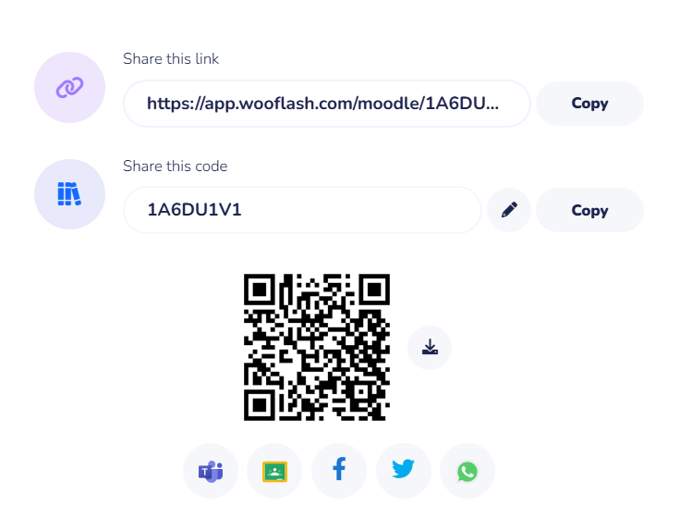
Review and Reflection from students

